Slide 1







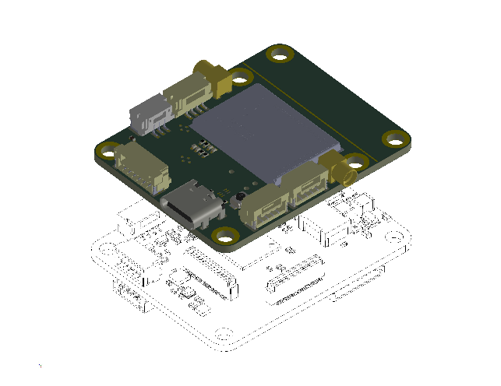
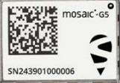
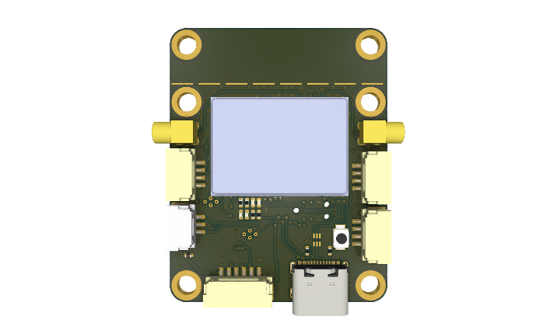

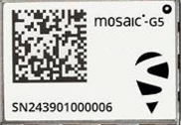
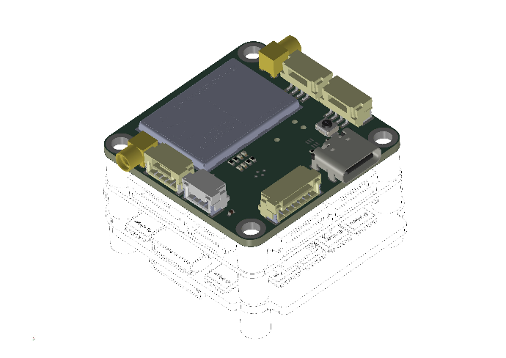
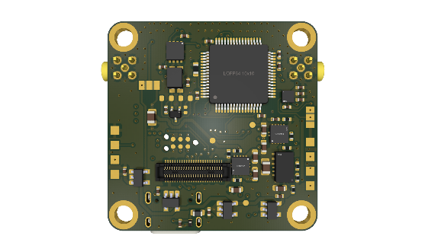
G5Fly
DroneCan
Magnetometer
G5Fly is an open-source board design based on the “FPV flight controller” form factor (30.5 × 30.5 mm), with an extended version (30.5 × 40 mm) and with DroneCan support. It is suitable for a wide range of applications including robotics, UAVs, and industrial embedded systems.
G5Fly
1
1
N° | Type | Device | Connectors
1 | Antenna | G5 P3(H) | MMCX male plug
2 | I²C 1 | STM32(G473) [I²C 1] | JST 4 pin
3 | PPS/EVENT | G5 P3(H) | JST 3 pin / DF40
4 | UART (RTS/CTS) G5 | G5 P3(H) [UART 2 – shared with interface 8] | JST 6 pin / DF40
5 | USB-2.0 | G5 P3(H) | USB-C
6 | CAN 11 | STM32(G473) + Transceiver (TJA1462ATK) | x2 JST 4 pin
7 | SPI1 | Magnetometer STM (LIS2MDLTR) | x4 Solder pads
8 | UART (RTS/CTS) G5 + PPS/EVENT1 | G5 P3(H) [UART 2 – shared with interface 3 and 4] | DF40 / JST 6 pin + JST 3 pin
9 | UART STM321 | STM32(G473) [UART 2] | x4 Solder pads
* | UART G5 | G5 P3(H) [UART 1] <-> STM32(G473) [USART 1] | Internal connection
2
6
3
6
MR-MCXN-T1 Hub
4
5
7
9
8
1 Optional at assembly
The board integrates the high-precision and resilient Mosaic-G5 P3(H), P6 or P8 module, delivering accurate positioning even in challenging environments.
An optional dual-antenna configuration enables precise heading output.
Any flight controller (30.5 x 30.5 mm)

Slide 2
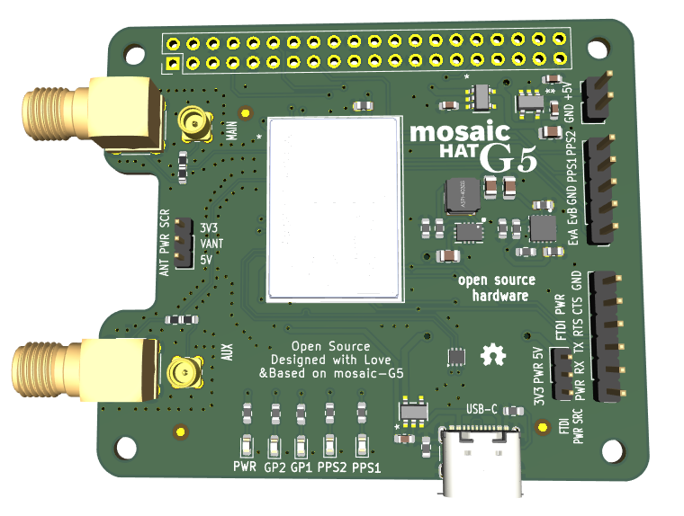
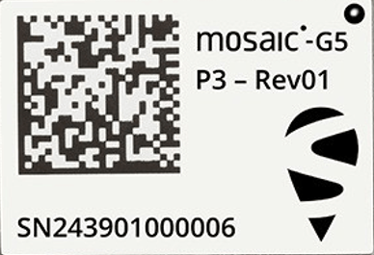
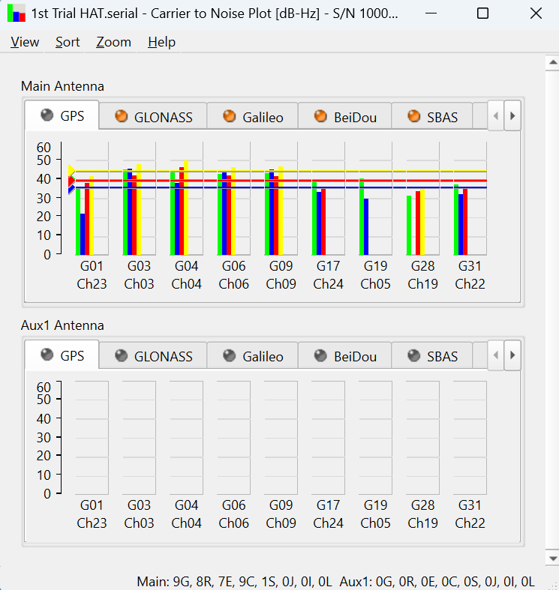
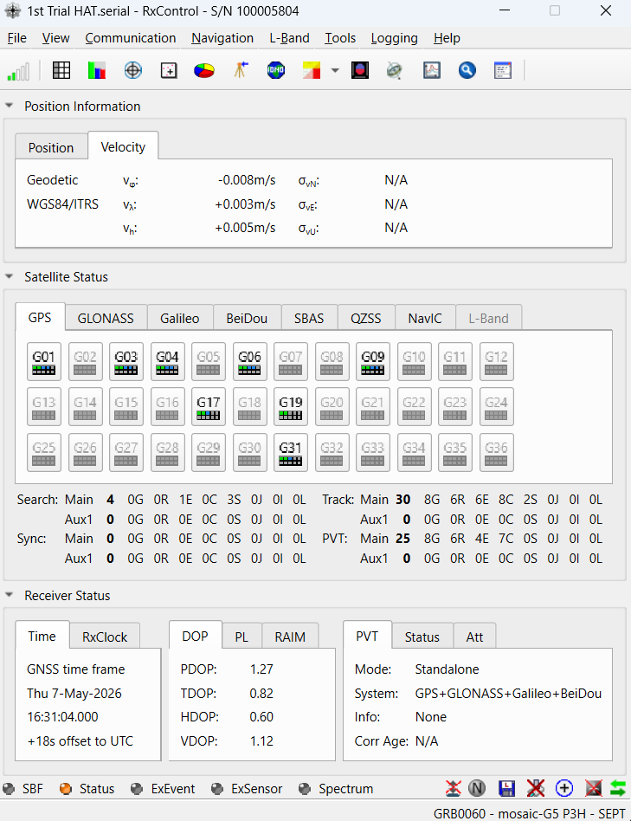

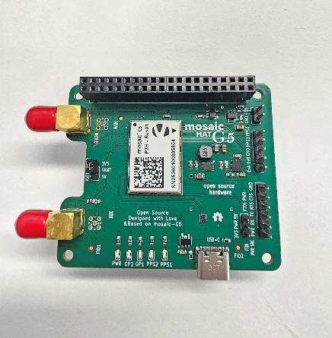


MosaicG5 HAT
Rpi connector
WHY
New version mosaic HAT
Reference design
Popularity Rpi
Building on success of previous mosaic HAT
POWER
MMCX
PPS
EVENT
SMA
UART
INNOVATION
Mosaic-G5 P3(H)
MMCX or SMA
USB-C
LEDs
USB-C
Thank you
WIM & KEN
STATUS
GOAL
Testing
Documentation writing
Open source GitHub
Find possible sales partner

